Slide 1
Coordinate System
There are a lot of different coordinate systems in existence
What is a coordinate?
A set of variables that allow us to position a geometric object
Typically the number of variables is equal to the number of dimensions in the coordinate system
3D game will have a coordinate made of three variables
Games in particular frequently some of these:
Cartesian coordinates
Polar coordinates
Cylindrical coordinates
Spherical coordinates
We are directly interested in Cartesian Coordinates

Slide 2
Cartesian Coordinate System
Rectilinear coordinate system
Rectangular in nature
Each coordinate is Orthogonal
Each axis of the space is perpendicular to the other axis
Each axis is 90 from one another
XNA is uses a right hand coordinate system
Positive Z is towards the screen
In a left handed the positive is away
Previously you have worked with 2 components vectors
Y
World Origin
X

Slide 3
Cartesian Coordinate System
Y
Previously you have worked with 2 components vectors
We will have 3 Axis to work with
X, Y, Z (Horizontal, Vertical, Depth)
Previous 2D subject was X, Y (Horizontal, Vertical)
Right handed coordinate system
Z axis is positive coming towards the viewer
Some game engines swap the Axis
Unreal Engine Y and Z Axis are swapped
World Origin
X
Z

Slide 4
Vectors
You already have a good understanding of using vectors
Previously you would have used Vector2(X, Y) to place object in *two dimensional space
In this module we will be using Vector3(X, Y, Z) to do the same thing
What is a vector?
A vector is the math equivalent to an array
A vector isn’t exactly a coordinate
It also has a direction (Angle) and a magnitude (Length)
We could say a coordinate is a vector from the origin (0, 0)
Or a vector is a coordinate offset from the origin (0, 0)

Slide 5
Vectors
A vector is defined by n-coordinates
Each component of the vector is typically assigned to an axis
Most games will use vectors with 2 or 3 components
Vector2 and Vector3
Vector4
Typically a vector is defined as or more two coordinates in a space
With two points we say the vector has a head and a tail
Starts at the tail, ends at the head
Vectors have their own relative space
Known as vector space
B
A

Slide 6
Vectors
Think of a vector as an arrow
Arrow indicates the direction
Starts at the tail and points towards the head
The head is the actual (X, Y, Z) components
The head can be placed anywhere in coordinate space
The only restriction is that is a given distance from the tail
If our vector is (1, 2, 3)
It is separated form the tail by a distance of (X=1, Y=2, Z=3)
On the right the tail is at the origin
The head is given distance from the origin
To calculate the value of the vector AB = (B - A)
Y
B
A
X

Slide 7
Vector Operations
Addition
Simple addition of two or more existing Vectors
Subtraction
Simple subtraction of two or more existing vectors
Scalar Multiplication
Multiply a Vector by a Scalar
Scaling the size of the Vector
Not multiplying by another vector
To multiply two Vectors we use the Cross Product
To get the angle between two vectors we use the Dot Product

Slide 8
Vector Operations
Cross Product
The cross product of two 3D vectors (A, B) will result in a new vector
The new vector is perpendicular to the vectors A and B
Dot Product
Produces a Scalar often known as the Scalar Product
Normalization
Creates a Unit Vector from a given vector
Transformations
Transforms a Vector by a given Matrix or Quaternion rotation

Slide 9
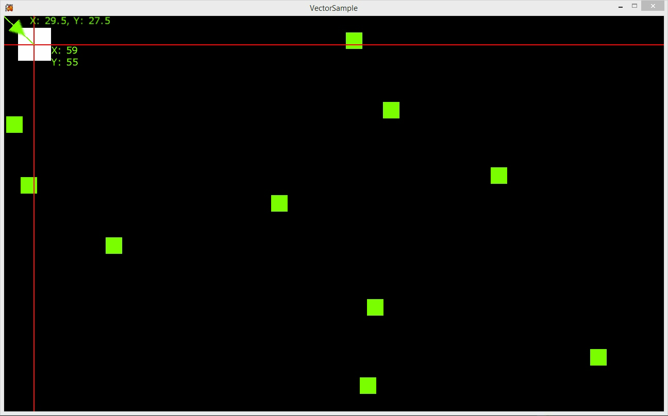
Vector2 Sample Application

Slide 10
Matrix
A Matrix is 2D grid of numbers
Can have as many rows and columns as are needed
Each element can store any numerical value
We can perform many arithmetic operations with a matrix
Addition
Subtraction
Multiplication
The matrix is one of the key data structures you will be using
Simplify representation and computation
Great at transformations
XNA matrix has a lot of built in functions

Slide 11
Matrices and Games Development
What does matrix mean for us?
Transformations
We will use the matrix to store the current transforms of our 3D objects
Translation
Rotations on each Axis (X, Y, Z)
Scale
When you produce a model in a modelling tool
The coordinate space origin is the centre of the model
We can use a matrix to transform the model from it’s local space to our game spaces
Will cover some issues that can arise when exporting later

Slide 12
Matrices
There are three core matrices that form the backbone of a most 3D games
World (Each objects transformation Matrix)
View
Projection
These matrices will allows use to transform our objects to be drawn on screen
Every 3D object to be drawn will need these
These will feature in a range of functions throughout the engine
And can serve many purposes (View Culling, Spatial Partitioning, etc.)
Camera Related

Slide 13
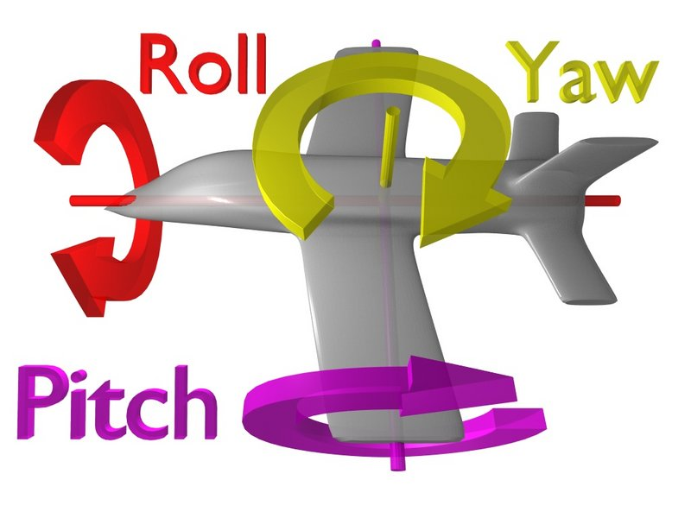
Yaw, Pitch and Roll

Slide 14
Yaw, Pitch and Roll
Yaw:
Called 'heading' also
Rotation of an aircraft, missile, etc, about its vertical axis
The Y axis in XNA
Pitch:
Rotation of an aircraft, missile, etc, about its movement of the longitudinal axis about the lateral axis
The X axis in XNA
Roll:
rotation of an aircraft, missile, etc, about its longitudinal axis
The Z axis in XNA

Slide 15
Projection Type
Perspective Projection
Creates a view frustum which is a pyramid.
Gives a sense of perspective.
Orthographic Projection
Creates a view frustum which is a cuboid.
The near and far planes are the same size.
All objects have the same size independent of distance to the camera.

Slide 16
Shapes
All 3D graphics are created using basic shapes
Points
Lines
Triangles
The basic elements are referred to as primitive objects
Primitive objects are
Drawn in 3D space
Use Cartesian coordinates (X, Y, Z)
Vector3 for positioning of elements

Slide 17
Primitive Types
Lines and Triangles can be drawn in two ways
List
Strips
List
Used for drawing separate shapes
Strip
Used when drawing a combination of shape
Combination to create more complex objects
3D models
More efficient than Lists
Saving memory
Faster drawing

Slide 18
Vertex
Even the most complex objects are constructed using primitive objects
A 3D model is a file containing vertex information
A vertex object stores information such as
X, Y, Z positions
Colour
Texture coordinates
Normal Vector
These vertices can be rendered by outputting points for each vertex
Wireframe (Lines between points)
Solid (Series of linked triangles)

Slide 19
Vertex Types
A vertex can store multiple types of data
Position
Colour
Texture Coordinates
Normal Vector
XNA provides 4 built in types
VertexPositionColor
VertexPositionTexture
VertexPositionNormal
VertexPositionNormalTexture

Slide 20
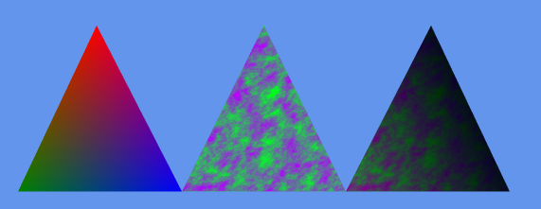
Vertex Types
VertexPositionColor
VertexPositionTexture
VertexPositionNormalTexture

Slide 21
VertexDeclaration
A vertex declaration stores the vertex format to be used when drawing objects
When drawing an object we must provide the graphics device with the correct format
Allows for the proper retrieval of data
Before drawing the graphics device vertex declaration property must be set
We can define our own vertex format
Using IVertexType
Will come back to this I the future

Slide 22
Drawing Primitives
Declare the vertex type
Set the primitive type
Lines or strips
An array of vertex data
If not using a model
Set the starting element in the vertex array
Set the number of primitives to be drawn from the vertex array

Slide 23
Summary
All 3D graphics are composed of simpler shapes
Lines
Triangles
These shapes are again composed of vertices
These vertices hold a lot of data
Position, Colour, Texture, Normals and other data
We can create our own but XNA provides 4 common ones
We send an array of these vertices to graphics device
Tell it what type of vertex data it is
Tell it how many and what primitive type we want to draw
Apply effect

Slide 24
Shaders Introduction
XNA uses shader based rendering
Converts vertex input data into pixel output data
XNA provides some built in effects (Basic, DualTexture, EnvironmentMap, AlphaTest)
Custom effects are also supported (HLSL)
Must be used when drawing 3D graphics
Shaders have high performance
Graphics processing is off loaded onto the GPU
Allows us to customize the way vertices are displayed on screen

Slide 25
Shaders Introduction
Shaders can be used to manipulate vertex data
Color, Position, Texture, Normal etc.
This additional processing capabilities allow us to add
Lighting
Blending effects
Transparency
Multi-Texturing
The built in XNA effects
Provide basic functions
Advanced features must be coded yourself using HLSL

Slide 26
Graphics Pipeline
Describes the process of converting vertex data and primitive inputs into pixel output
Vertex and Pixel shaders play a key role in this process
Note that there are versions of Vertex and Pixel Shaders
XNA supports up to 3.0/3.1
Xbox and Windows
DirectX 9
MonoGame supports up to 5.0
Windows 7 and Windows 8
DirectX 11, DirectX 11.2

Slide 27
Vertex Shader Overview
Applies transformation to input vertex data
World, View, Projection
Non visible vertices are clipped
Back faces of primitives are removed
Back face culling
Can be disabled
Rasterization converts the data into an output image
Interpolation is used to uniformly distribute vertex data between coordinates

Slide 28
Vertex Shader
A vertex shader can be used to alter and draw any vertex property
Lighting
Modifying positions
Changing colour
Adjusting image coordinates
Can use a range of other inputs to achieve desired results
Can be passed via game code
Internal
At the very least the vertex shader must output position data

Slide 29
Pixel Shader Overview
Applies
Coloration
Texturing
Various imaging effects can be applied at this stage
All before outputting the final image to the screen

Slide 30
Pixel Shader
Pixel shaders convert vertex data from the vertex shader into coloured pixel data
Cannot alter position or normal data
Can use it for lighting, colouring, texturing, blending
Pixel operation are more expensive than vertex ones
Sometimes the results are richer, even at a higher cost
When complete the shader outputs the coloured pixel data to the graphics card
One pixel at a time

Slide 31
Techniques and Passes
A technique defines the vertex and pixel shaders used in a pass through the pixel rendering stage
In most cases drawing is done in one pass
Sometimes there may be more than one pass for effects
multi-texturing
water

Slide 32
Bounding Box
A box shaped bounding volume that can be used for basic collision detection
Uses min and max vectors to define it’s size
Manually defined
Extracted from model
Axis Aligned Bounding Box
Needs to be continually updated it the object is dynamic

Slide 33
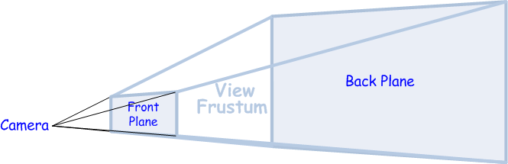
Bounding Frustum
Defines the shape of our View * Projection
Rectangular Pyramid
Typically only used with cameras
Will feature later in the semester for the removal of objects that cannot be seen
Object culling

Slide 34
Bounding Sphere
Axis Aligned Bounding Sphere
A bounding volume in the shape of a sphere
Requires a Position and Radius
Can be used when making more complex objects that require more complex shapes

Slide 35
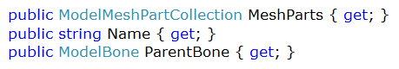
ModelMesh
The key members of the ModelMesh we are interested in are:
Name
MeshParts
The collection of MeshParts that make up the mesh
Set of primitives that share a material
ParentBone
Contains a transformation matrix that describes how the mesh is located relative to any parent meshes in a model.

Slide 36
ModelMeshPart
We don’t typically need to go anywhere near the mesh parts
For some advanced rendering techniques then we do
Binary Spatial Partitions would require this kind of access
A mesh part is nothing special, it’s core components are
A Vertex Buffer
An Index Buffer
An Effect
The same components we have used to draw our simple shapes
ColourTriangle etc.
Just declared the vertex data required
The mesh part holds this kind of data for a 3D model

Slide 37
Vertex Stride
Distance from the beginning of one entity to the beginning of the next entity
Stride is the size in bytes for the data of one vertex
Byte offset from consecutive vertices
In order to access each piece of vertex data we must know the stride to be able to iterate over the byte data

Slide 38
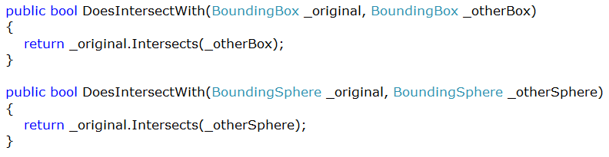
Intersection Checks
We can easily check if two bounding volumes intersect
Intersects(volume) returns a Boolean
Typically we want to compare
Box to Box
Sphere to Sphere

Slide 39
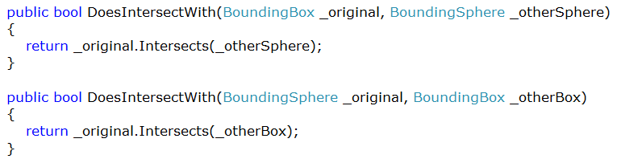
Intersection Checks
Of course will have a mixture of volumes in the game
And we can check intersections the exact same as before
Box to Sphere
Sphere to Box

Slide 40
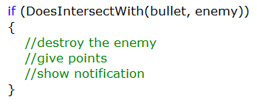
Intersection Example
Note that you would not use a check like this for bullets in a game
If we used the previous methods to check intersections then we could easily make decision in game objects
What type of object intersected and what is the response to that
Later we will use a physics engine so building this kind of cod into your games will require a re-write later

Slide 41
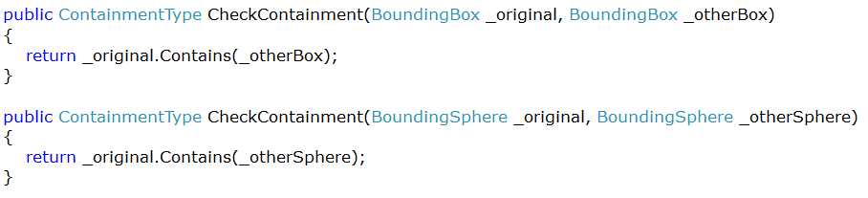
Containment Checks
We can determine the containment state of two volumes
This is used to determine if an object is within another
It tells use the type of containment
Disjoint (None)
Intersects (Partial Containment)
Contains (Fully Contains)

Slide 42
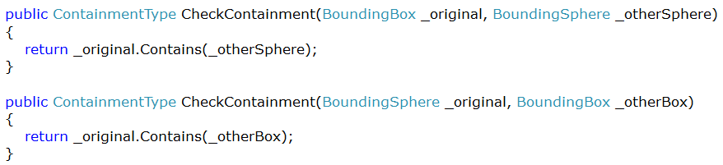
Containment Checks
Just like the intersections we can check
Box to Box
Sphere to Spere
Ray to Box
Ray to Sphere

Slide 43
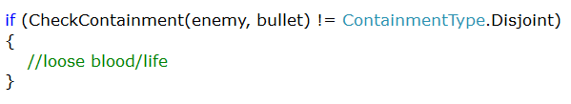
Containment Sample
Again not good for bullets!
If the containment type is anything other than disjoint (none) then take some life of the game object
This can be used with the Camera Frustum to check what game objects are visible
Contained in the view frustum
Object culling

Slide 44
Ray
The Ray in XNA has a
Vector3 Position
Vector3 Direction
Previously mentioned ray casting is frequently found in games
Ray Picking
Keeping object off the ground
Graphics
Casting a ray from the centre of a screen (crosshair) is a typically usage scenario

Slide 45
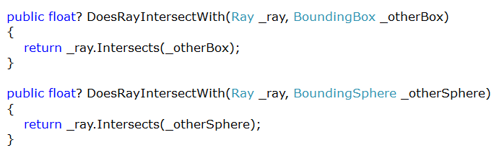
Ray Intersection
Unlike the previous Intersections which returned a bool
Ray returns a nullable float (float?)
If the result is null then no intersection took place
If the result has a value then there was an intersection
And the result is the distance from the source of ray to the intersection
Really goo 3D picking

Slide 46
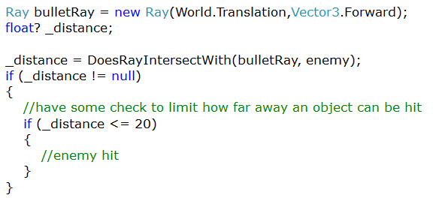
Ray Intersection Sample
Perfect form of collision detection for a bullet
An infinite line from a source in a direction
We do the intersection
Check if not null
Check if within a limit of 20 units
If it is then do something to the enemy

